Slide 1

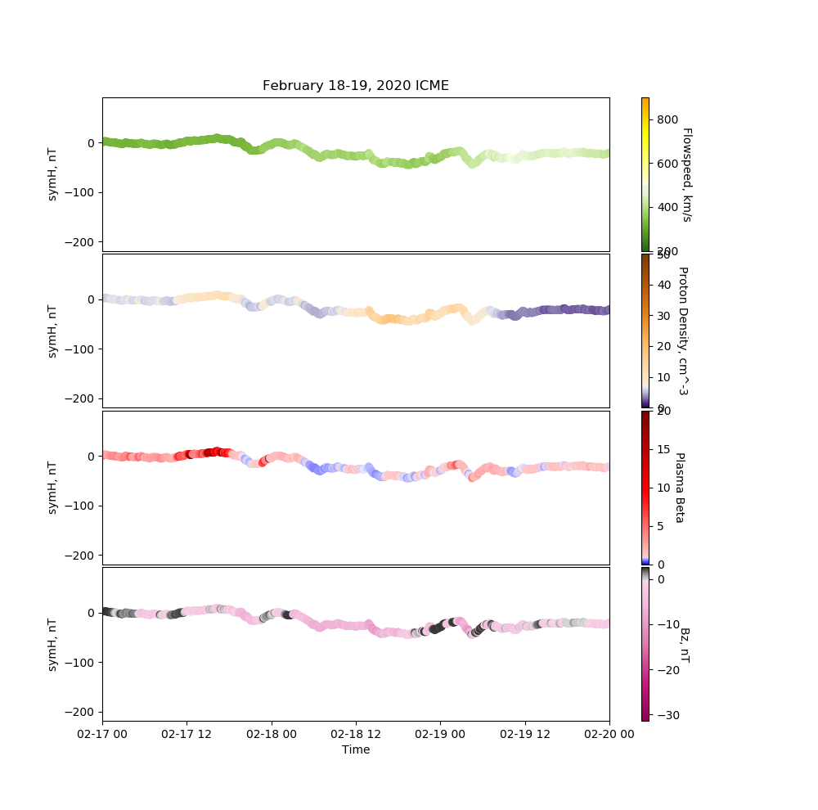
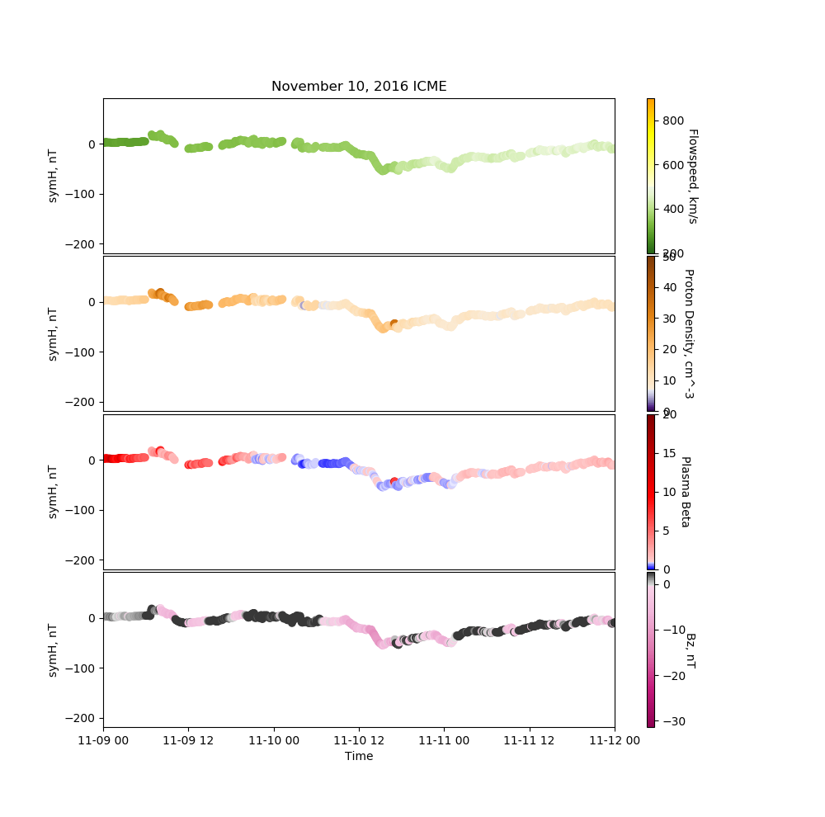
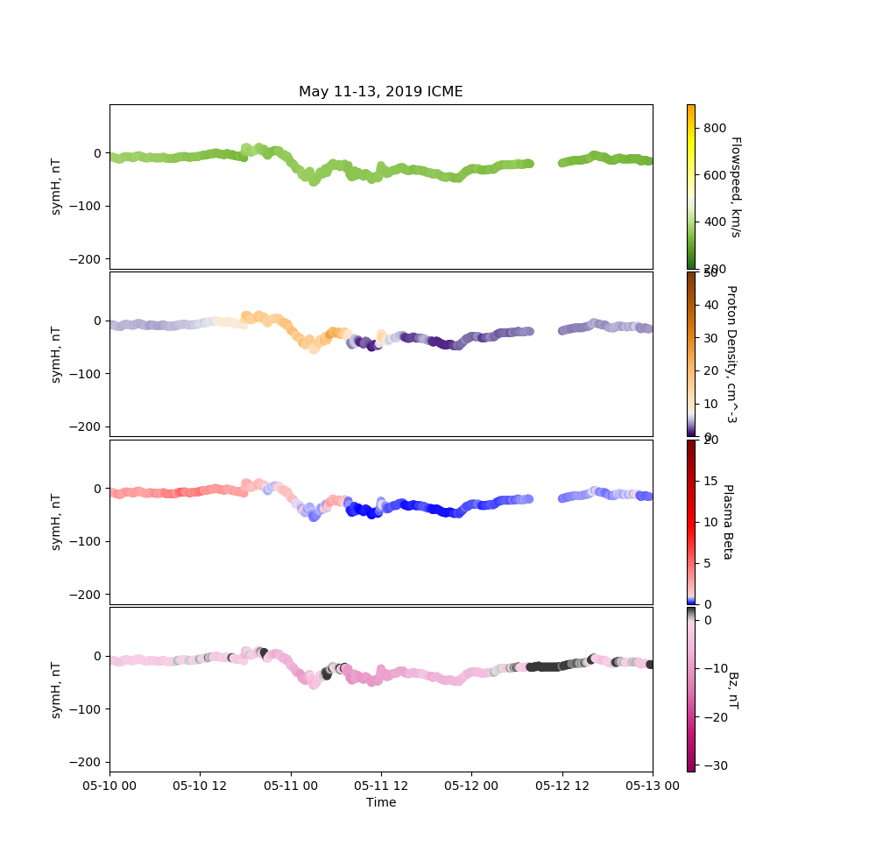
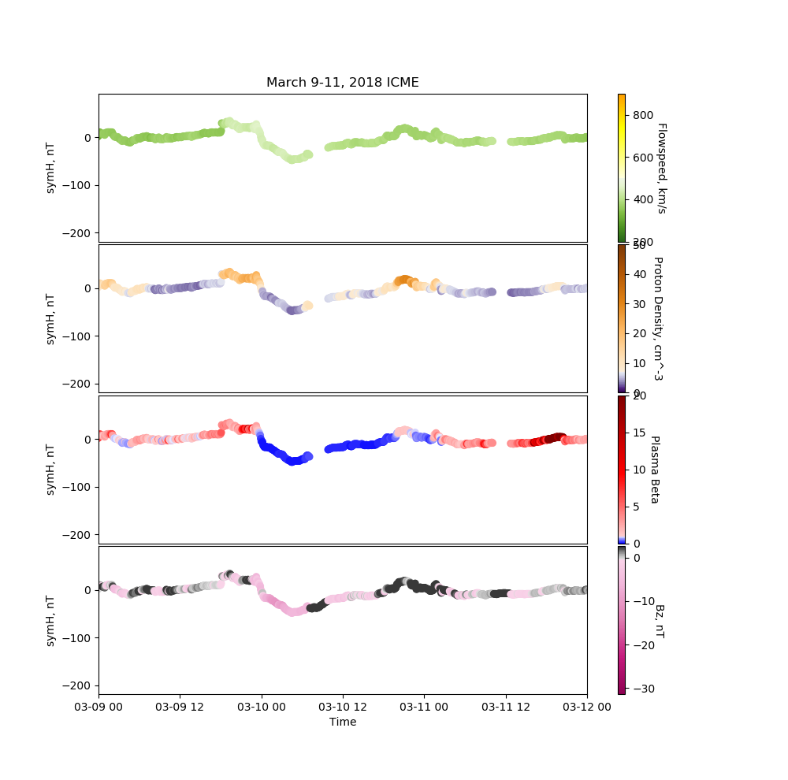
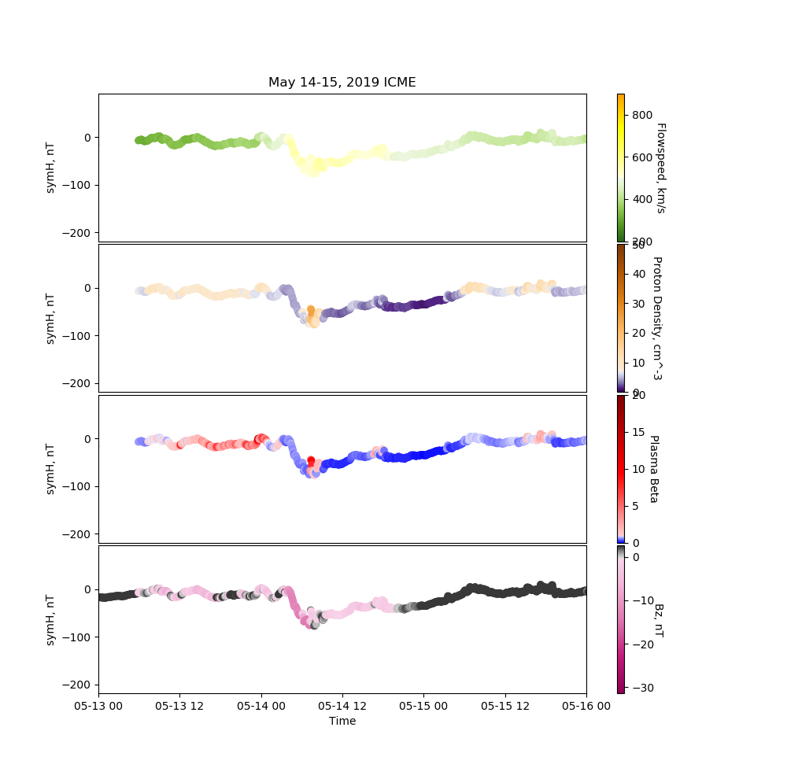
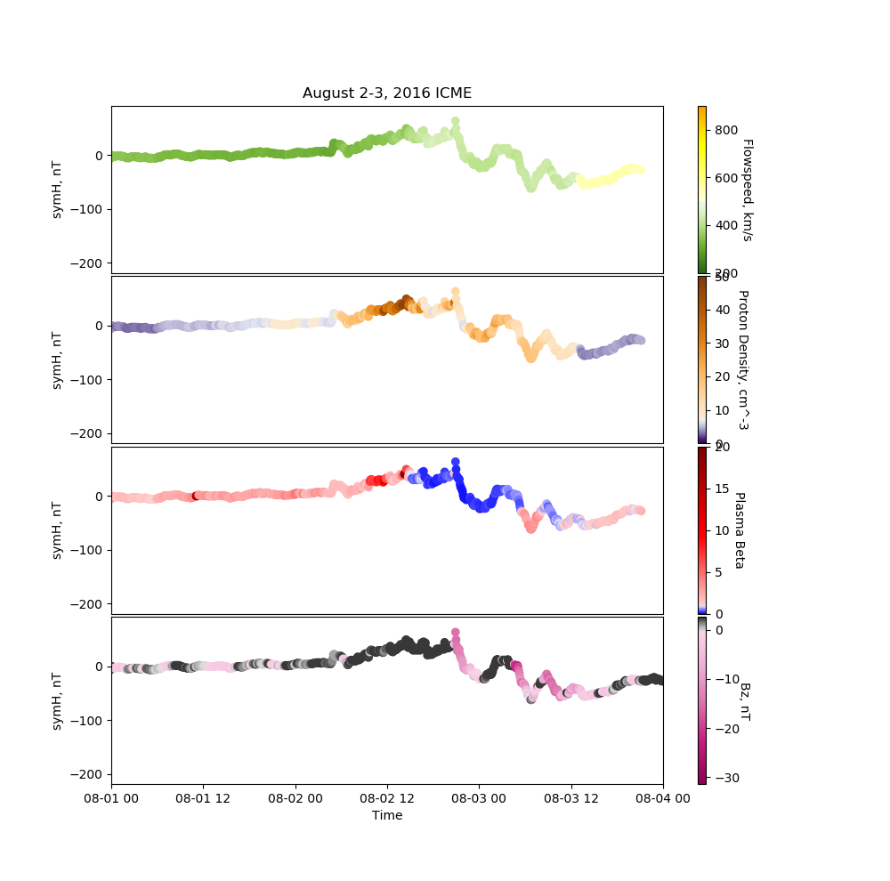
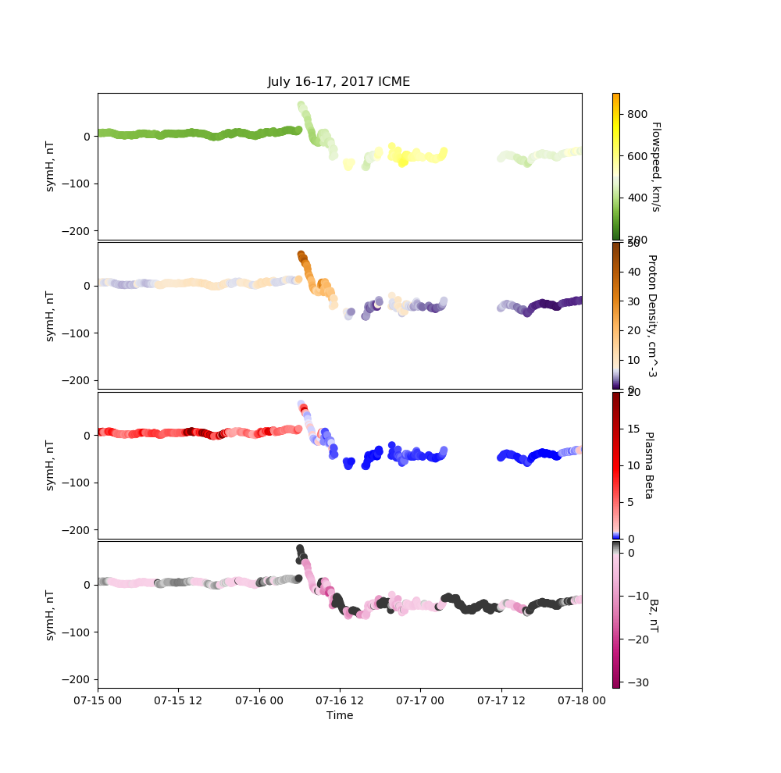
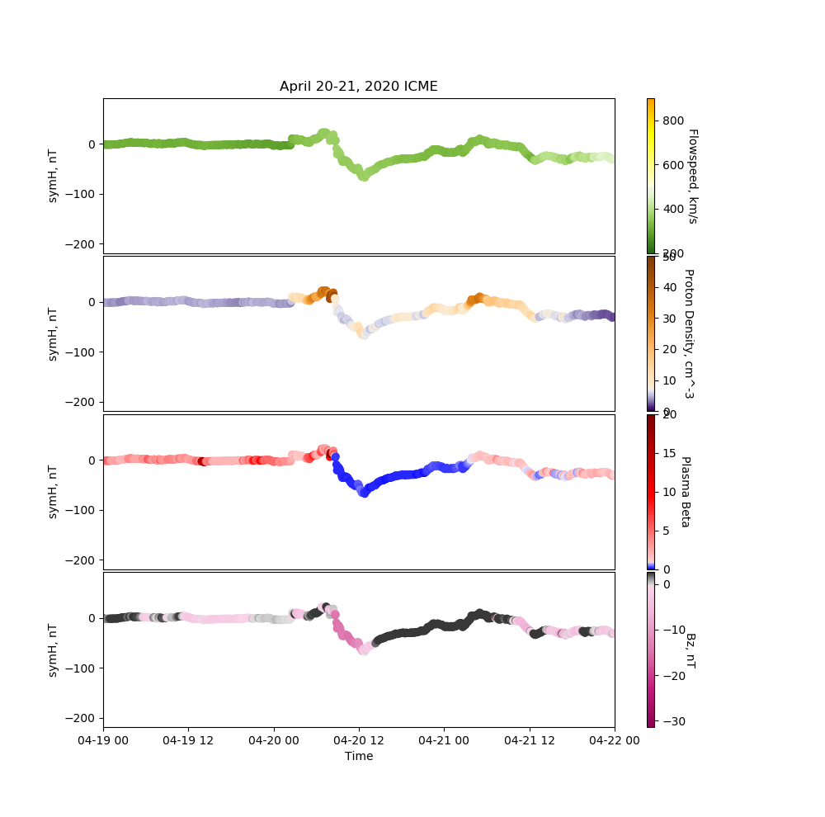
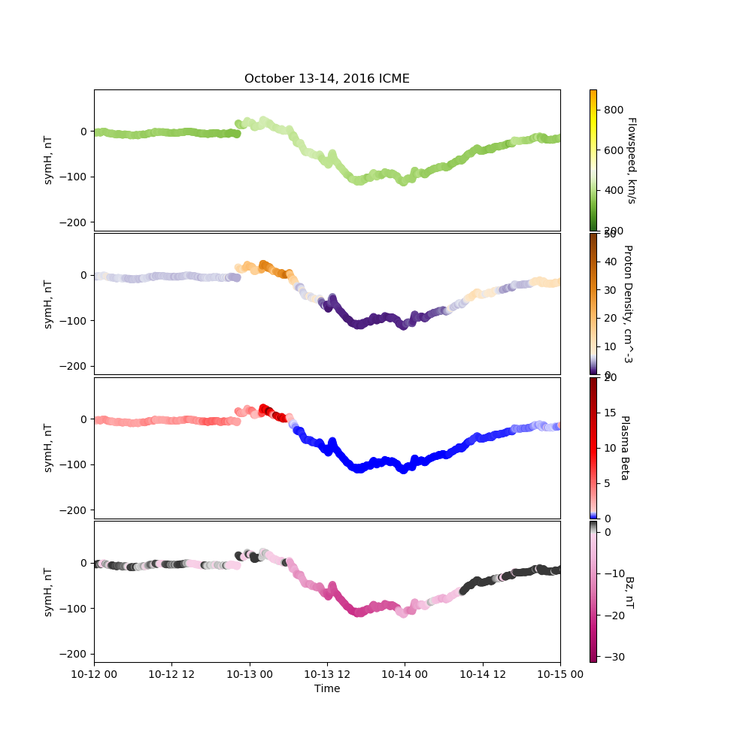
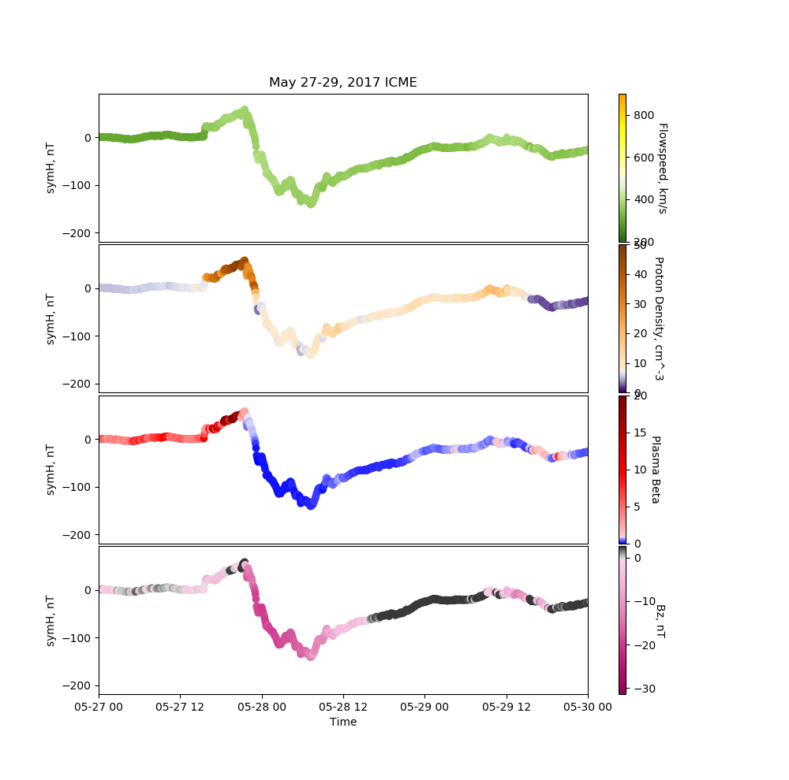
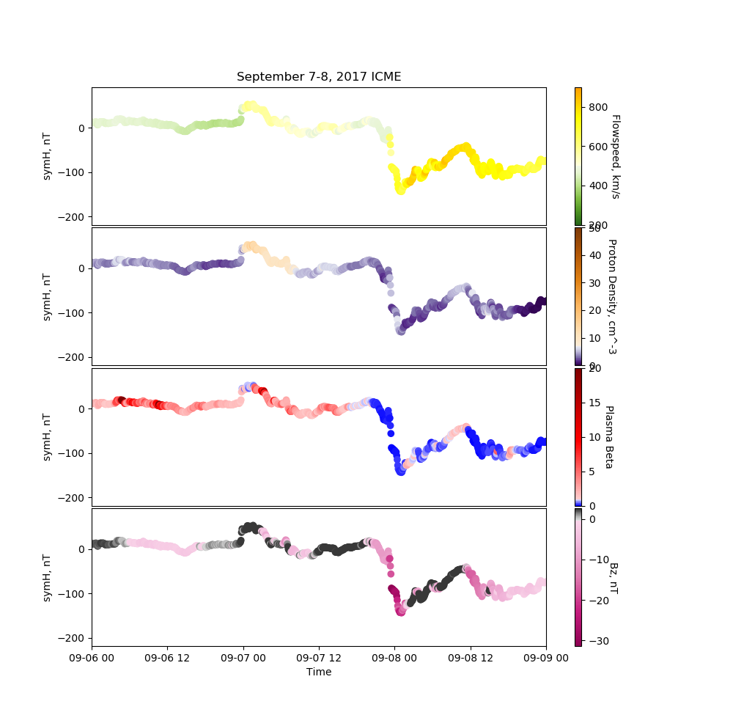
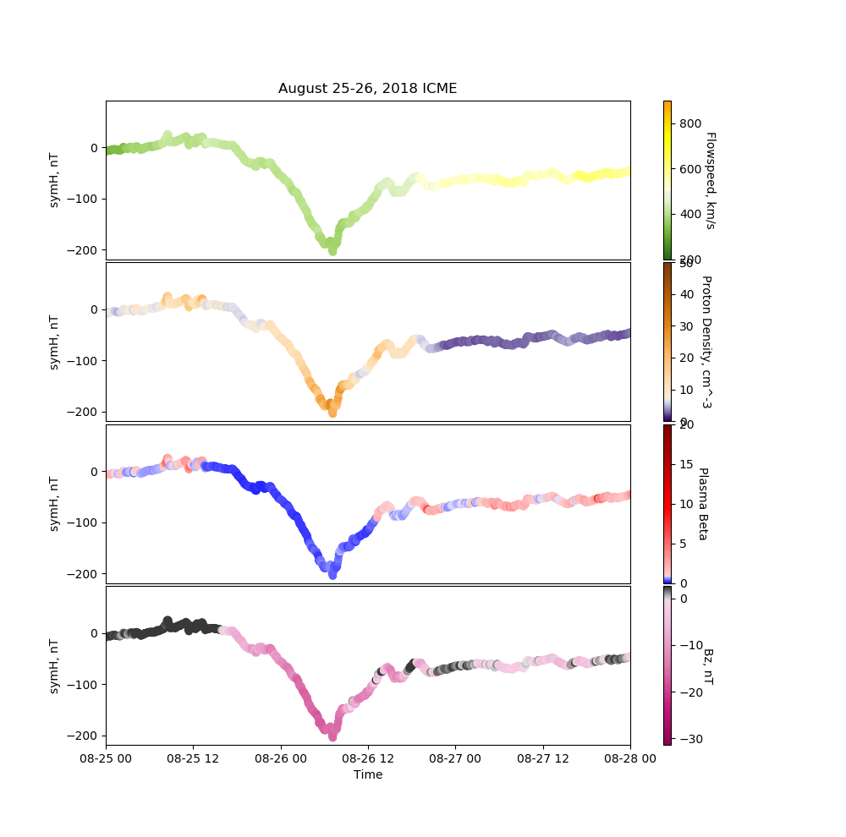
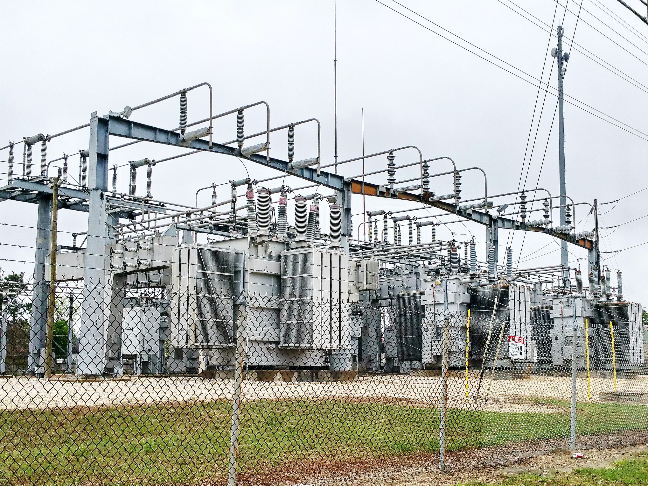
Is the Sun Knocking Out Your Electricity?
Grace Cappella & Sarah McGregor
Abstract
Electrical technology’s heavy reliance on transformers has increased the importance of research into the causes of geomagnetic storms. The damage inflicted on transformers may result in mass blackouts. In particular, we considered storms triggered by interplanetary coronal mass ejections (ICMEs), where the sun flings plasma towards Earth. Recent data from NASA’s Coordinated Data Analysis Web showed that storm intensity during an ICME is affected by solar wind characteristics, including speed, density, plasma beta, and magnetic field components. This research looks at data collected near solar minimum in cycle 24, because it is easier to identify the direct results of the ICME when there are fewer disturbances. If we can begin to isolate the characteristics which cause the largest storms, we can predict when they will happen, so that power companies can take measures to mitigate damage.
Moderate Storms with Gradual Start (peak less than -100 nT)
Color Key
Flowspeed
-fast wind <500 km/s
-slow wind >500 km/s
Proton Density
-measures the density of the particle stream which makes up solar wind
Plasma Beta Ratio
-thermal pressure dominates <1
-magnetic pressure dominates >1
Bz
-upward disturbance in
magnetic field >0
-downward disturbance in
magnetic field <0
Data
The ICME dates and solar wind data used in this analysis were obtained from CalTech and NASA’s open databases.
Of the 33 ICMEs in this time period (2016-2020), these 12 were chosen due to the availability of data and lack of prior disturbances in Earth’s magnetic field, which could obscure whether these effects truly resulted from the ICME.
Moderate Storms with Steeper Start (peak less than -100 nT)
Strong Storms (peak greater than -100 nT)
Background
All electronics depend
on transformers,
whether tiny
ones embedded in
devices or the walls of
a house, or larger ones
as seen at power
plants. Over long
distances, electricity
travels best at higher
voltages down thin
wires, but that high
voltage is too much for our day-to-day use. Transformers reduce that voltage to usable levels when it reaches its destination.¹ Multiple reductions are often required to reach a safe voltage.
In a coronal mass ejection, magnetic forces fling large amounts of plasma from the sun’s corona into space.² If the eruption is directed towards Earth, it is called an interplanetary coronal mass ejection (ICME), and may cause damage and technological malfunctions. The particles streaming from the sun hit Earth’s magnetic field and cause it to shake, which generates massive electrical currents in the atmosphere and at ground level. When these currents interact with transformers, electrical overload can occur, causing large-scale blackouts. Compounding the problem, transformers damaged by solar wind cannot be repaired. Replacements may take over a year to be manufactured and installed.³ And most transformers have no protection against solar storms.
Analysis
We sought to identify conditions during an ICME that lead to stronger storms, and thus greater potential impact on transformers. The graphs above show changes in the symH index, which measures disturbances in Earth’s magnetic field. The strongest storms seem to be associated with the largest downward disturbances in the magnetic field (pink). These storms also display a high magnetic pressure (blue), and the densest particle streams (orange). Flowspeed is nearly always in the “slow wind” range, below 500 km/s (green). All three of these conditions seem to be necessary for maximum effect. Interestingly, in the September 2017 storm, magnetic pressure briefly dominated, but then flowspeed spiked, which seems to have delayed the downward disturbance in the magnetic field. Only when flowspeed briefly fell below 500 km/s again did the impact occur.
The scope of this project was necessarily limited by time constraints. Further research is needed to determine whether this cluster of conditions is unique to ICMEs, or if other disturbances may cause similar conditions and the same effect. CalTech has recorded ICMEs as far back as 1996, so analyzing the entire available data range may strengthen or change these conclusions. Studying impacts on transformers in various parts of the globe during ICMEs could also tell us which areas are most vulnerable to the resulting currents, and thus where to focus preventive measures.
References
(1) https://edisontechcenter.org/Transformers.html
(2) https://www.swpc.noaa.gov/phenomena/coronal-mass-ejections
(3) https://science.nasa.gov/science-news/science-at-nasa/2010/26oct_solarshield
ICME & Solar Wind Data Sources
http://www.srl.caltech.edu/ACE/ASC/DATA/level3/icmetable2.htm
https://cdaweb.gsfc.nasa.gov/index.html/
Photo References
Transformers: photo by ETA+ on Unsplash

